Slide 1
Litigating in the Age of Generative AI
Presented by Sam Lamble (Deloitte); Duncan Willis (Barrister) and Priscilla Blackadder (Barrister)

Slide 2


What are the concerns that arise from use of AI in practice
General Concerns
  speed of development and lack of regulation= a perfect storm?
Legal practice specific concerns
Information accuracy – bias? Hallucinations?
Lack of confidentiality – data privacy? client confidentiality? privilege considerations….
- In Australia, there is indirect regulation through various legislation such as:
- Competition and Consumer Act 2010 (Cth);
- Copyright Act 1968 (Cth); and
- Privacy Act 1988 (Cth)
- Australian Government Discussion Papers; Consultations and Proposal Papers:
  Supporting Responsible AI – interim response released 17 January 2024: https://consult.industry.gov.au/supporting-responsible-ai
  Introducing mandatory guardrails for AI in high-risk settings: Proposals paper for introducing mandatory guardrails: Introducing mandatory guardrails for AI in high-risk settings: proposals paper - Department of Industry, Science and Resources

Slide 3
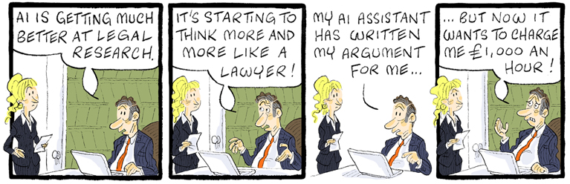
Potential Negative Implications for Lawyers
- implications for lawyers personally and the broader legal community
- reduction in quality of legal service
- reduction in public confidence
- worst case: breach of professional and ethical obligations – possibly legal obligations…

Slide 4

Copyright and broader intellectual property implications?
ChatGPT does not provide source reference or explanations for output data – avoid using AI responses verbatim, use own skill and judgment in respect of output data and use DISCLAIMERS
AI licence terms – CHECK
At heart of intellectual property creation is human authorship
Unauthorise reproductions – risk of infringement claims

Slide 5

Information Accuracy?
What happens when your lawyer relies on ChatGPT without checking the information before tendering it in Court
- A case study from US – U.S. District Court for the Southern District of New York, Mata v. Avianca Inc., Case No. 22-CV-1461

Slide 6
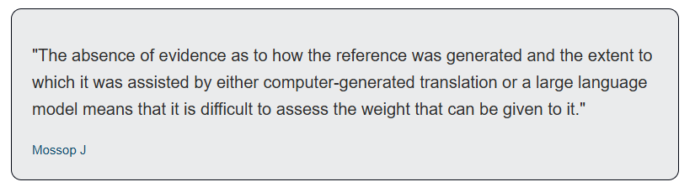
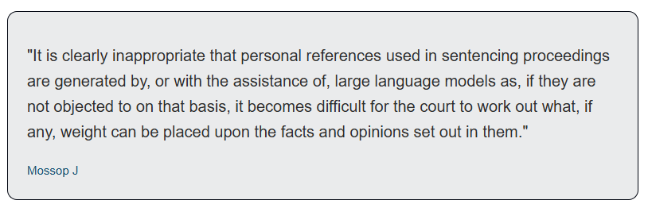
Information Accuracy?
.
Closer to home - are AI hallucinations creating a legal nightmare???
Handa –v- Mallick [2024] FedCFamC2F 957: List of Authorities produced by AI - hallucinations… potential referral of lawyer to the regulator by judge..
DPP –v- Khan [2024] ACTSC 19: ACT Supreme Court: issue character reference generated by AI = little weight placed on it

Slide 7
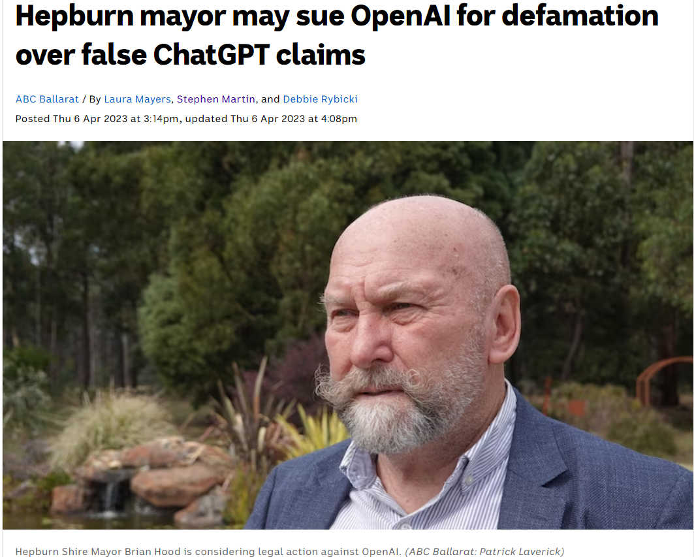
Information Accuracy?

Slide 8
Ethical Obligations: Duty to act competently and diligently
Rule 4 in the Legal Profession Uniform Law Australian Solicitors’ Conduct Rules 2015 (‘Solicitors’ Conduct Rules’) provides that a solicitor must ‘deliver legal services competently, diligently and as promptly as reasonably possible’.
- Lawyers must:
- have the requisite skills to harness new technologies, while understanding their limitations and parameters of use.
- choose AI-powered tools that are fit for their intended purpose and understand the risks of the technology, for example, the accuracy and potential biases of underlying data used to train the tool, whether that underlying data has been properly cleared for use, and the accuracy of any resulting information

Slide 9
Ethical Obligations: Duty to the Court and Administration of Justice
Rule 3 in the Legal Profession Uniform Law Australian Solicitors’ Conduct Rules 2015 (‘Solicitors’ Conduct Rules’) provides that a ‘solicitor’s duty to the court and the administration of justice is paramount and prevails to the extent of inconsistency with any other duty.’
- Unlike Mr Scwartz in the USA who we saw earlier relied on ChatGPT to provide his case citations, lawyers should not rely on AI-powered tools that may produce inaccurate case citations, incorrect information, or oversimplify legal concepts.
- They must review AI-generated information to ensure it is accurate, relevant, and justifiable before using it to avoid breaching their duties to the Court.
- Use of technology assisted review in discovery – Supreme Court of Victoria Practice Note SC Gen 5 – Technology in Civil Litigation (First Revision): ‘the use of common technologies is a core skill for lawyers and a basic component of all legal practice’.

Slide 10
Ethical Obligations: Duty to act in the best interests of the client
Rule 4 in the Legal Profession Uniform Law Australian Solicitors’ Conduct Rules 2015 (‘Solicitors’ Conduct Rules’) also requires that a solicitor ‘act in the best interests of a client in any matter in which the solicitor represents the client’
- Lawyers must ensure that using AI-powered tools does not damage the quality of their legal work by properly auditing and interrogating the information generated before using it or incorporating it in advice.
- This obligation also contemplates the ethical billing of clients

Slide 11
Ethical Obligations: Confidentiality and Legal Professional Privilege
Rule 4 in the Legal Profession Uniform Law Australian Solicitors’ Conduct Rules 2015 (‘Solicitors’ Conduct Rules’) also requires that a solicitor must not disclose any information which is confidential to a client and acquired by the solicitor during the client’s engagement, subject to specified exceptions.
- When using AI-powered tools, a lawyer’s obligation to not disclose confidential client information extends to ensuring the technology is secure and omitting sensitive details so unauthorised parties cannot access or share the client’s details.
- When using AI-powered tools, a lawyer’s obligation to not disclose confidential client information extends to ensuring the technology is secure and omitting sensitive details so unauthorised parties cannot access or share the client’s details.

Slide 12
Ethical Obligations: Independence
Rule 4 in the Legal Profession Uniform Law Australian Solicitors’ Conduct Rules 2015 (‘Solicitors’ Conduct Rules’) specified that solicitors must ‘avoid any compromise to their integrity and professional independence’
In relation to advocacy, rule 17.1 requires that a lawyer must not act as a mere mouth piece for the client
- breach might occur where lawyers have not acted independently and blindly relied upon the results of AI-powered tools.
- In discharging their duty lawyers must consider the inaccuracies and bias that can be embedded within these tools. Therefore, lawyers must not mimic the responses provided by AI-powered tools

Slide 13
Courts’ views on AI
Supreme Court of Victoria - ‘Guidelines for Litigants – Responsible Use of Artificial Intelligence in Litigation’.
  Directed at lawyers and non-lawyers.
  Makes clear that parties and practitioners should ensure that they have an understanding of how the AI tools they are using work, as well as their limitations.
  Encourages parties to disclose the use of AI to other parties and the Court where appropriate.
  Encourages practitioners to consider use of AI to improve productivity, especially in large document reviews.
  Makes clear that the use of AI is subject to practitioners’ obligations to the Court and those imposed by the Civil Procedure Act 2010. Parties or practitioners signing or certifying documents or filing documents with the Court remain responsible for the accuracy of its contents.
  Urges caution on using AI tools for preparing evidentiary material.

Slide 14
Courts’ views on AI
Supreme Court of New South Wales – Practice Note of ‘use of generative artificial intelligence’.
Takes a somewhat more restrictive approach than the Supreme Court of Victoria.
Urges parties to be aware of the risks, including hallucinations, bias and loss of confidentiality.
Prohibits entering information into an AI program that is subject to the Harman undertaking, unless the practitioner is satisfied that that information will not be used to train large language models.
Prohibits use of AI in generating the contents of evidentiary material.
Prohibits use of AI in drafting or preparing the content of expert reports without leave.

Slide 15
Courts’ views on AI
Decision writing
The Supreme Court of Victoria’s guidelines state that ‘AI is not presently used for decision making nor used to develop or prepare reasons for decision because it does not engage in a reasoning process nor a process specific to the circumstance before the court.’
The Administrative Review Tribunal’s Code of Conduct for Members prohibits using AI to obtain guidance on the outcome of a proceeding or producing any part of the Member’s reasons for a decision.

Slide 16
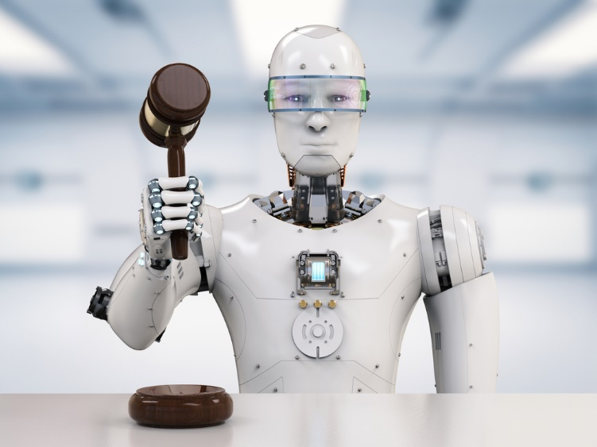
Key take away
Lawyers should use and moreover embrace technology but need to be forensic about what technology they should choose and the degree of knowledge they should have.
Lawyers do not need to be experts in AI but adherence to the Uniform law and conduct rules remains applicable to them (eg Uniform Conduct Rules in their jurisdiction) – remember ignorance to professional obligations is no defence!

Slide 17
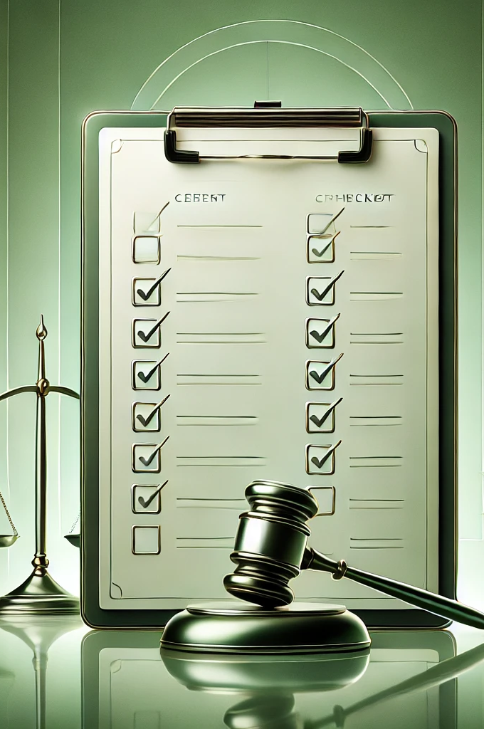
Checklist
KNOW the applicable legal professional conduct rules and standards that apply.
UPHOLD confidentiality, data protection and legal professional privilege by not distributing client information or other sensitive or confidential information to AI-powered tools. Opt out of data retention and other measures offered to minimise risk.
ENSURE YOU have sufficient understanding of AI-powered tools including any embedded bias and the accuracy of the data sources that the tools use to deliver their outputs.
CONTINUE to develop legal skills and knowledge to maintain competence as a lawyer and prevent over-reliance on AI-powered tools.
AVOID using AI responses verbatim, use own skill and judgment in respect of output data and use DISCLAIMERS
CONSULT senior personnel and develop firm guidance on whether the firm allows the use of the AI-powered tools and what procedures to follow.
KEEP UP TO DATE with developments in AI, including the regulation of AI, and accompanying ethical concerns raised by stakeholders.
ANALYSE AND SCRUTINISE the tools before implementing them and continue to supervise and review their uses to ensure they are appropriate and there is sufficient control over their uses.
If a PRINCIPAL of a LAW FIRM – EDUCATE and SUPERVISE YOUR LAWYERS ON AI (ethical and professional) and ADOPT framework compliant with LPUL and ASCR.

