Slide 1
Trusts & Insolvency:
Won’t somebody please think of the creditors?!?
Brenton Devanny

Slide 2

Trust basics
A trustee has as an incident of office an entitlement in equity to be indemnified out of the trust assets (by way of recoupment of past expenditure or exoneration from existing liability) for expenses and liabilities properly incurred by the trustee in the execution of the trust and that the trustee has a beneficial interest in the trust assets commensurate with that entitlement to indemnification which takes priority over the beneficial interests that the persons for whose benefit the trustee is bound to administer the trust assets (the cestuis que trust) have in the trust assets.

Slide 3
Insolvent Trustee Basics
The entitlement to indemnification and the commensurate beneficial interest that the trustee has in the trust assets survive replacement of the trustee by a successor trustee.
Common provision in a trust deed that the trustee is removed or disqualified on liquidation.

Slide 4
What about the creditors?
Creditors in the winding up of the corporate trustee prove in the winding up.
Liquidator of the trustee chases the new trustee for its indemnity out of the trust assets.
New trustee dissipates the assets of the trust.
Issue – does the new trustee have a fiduciary duty to the former trustee (and its creditors) to not dissipate the trust estate?

Slide 5

Naaman v Jaken Properties Australia Pty Limited [2025] HCA 1

Slide 6
Fiduciary Duties
On appeal from the Court of Appeal of the Supreme Court of New South Wales, the High Court found (4-3) per Gageler CJ, Gleeson, Jagot and Beech-Jones JJ that:
a successor trustee does not owe a fiduciary obligation to a former trustee in respect of the entitlement of the former trustee to indemnification out of the trust assets or the commensurate beneficial interest that the former trustee has in the trust assets.
Accordingly, creditors of the former trustee (as subrogated) cannot seek equitable remedies against parties knowingly assisting the successor trustee’s breaches of trustee duty.

Slide 7
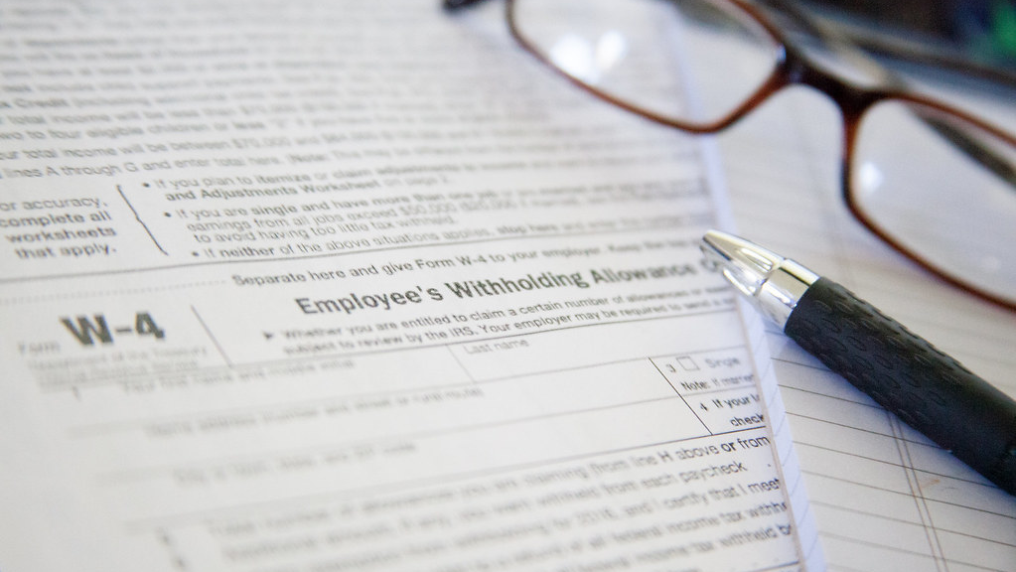
Factual background
Former Trustee - Jaken Property Group Pty Ltd (JPG) has a sole director and shareholder (PS)
Trust named ‘Sly Fox Family Trust’ – PS is Specified Beneficiary, Default Beneficiary and Appointor of trust.
.

Slide 8

JPG > Jaken
JPG purchases assets, found at trial as trustee of the Sly Fox Family trust
  2 apartments in Southbank;
  A Hotel in Kings Cross;
  A development site in Granville, NSW.
Extensive litigation ensues, after some appeals Mr Naaman obtains judgment against JPG as trustee in 2006 in excess of $3.4M.
On 13 February 2007, Jaken Property Group Pty Ltd retired as trustee and PS appoints Jaken Properties Australia Pty Ltd as trustee. PS’s brother appointed as director.

Slide 9


JPG
Two weeks later, JPG entered a creditor’s voluntary winding up
The only recorded liability was a $2500 unsecured debt to PS’s accountant
JPG was subsequently deregistered
Naaman as a judgment creditor was subrogated to the former trustee’s entitlement of indemnification.

Slide 10

Jaken v Naaman
Primary judge found that Jaken dishonestly and fraudulently transferred trust assets to third parties leaving insufficient trust assets to satisfy JPG’s right to indemnification.
Primary judge found PS an unreliable witness whose evidence could not be accepted as truthful unless it was against interest or corroborated by reliable contemporaneous documents, but also that a series of documents produced by him were inauthentic.
None of these findings were challenged on appeal

Slide 11
JPG > Jaken
Between 2012 and 2014, Jaken used various means to dissipate the assets of the Trust so as to put them beyond the reach of JPG. The Granville property and the Southbank apartments were transferred to companies associated with PS’s sister.
By a series of transactions, Jaken transferred 3.6million to a related entity of PS, leaving nothing to unsecured creditors.
The third parties were found to be knowingly involved in all of this conduct or to have received assets of the Trust (otherwise than as bona fide purchasers for value without notice). These findings were not challenged on appeal.

Slide 12

Outcome
A successor trustee does not owe a fiduciary obligation to a former trustee in respect of the entitlement of the former trustee to indemnification out of the trust assets or the commensurate beneficial interest that the former trustee has in the trust assets.
Jaken is not in a fiduciary relationship with JPG. Therefore, Jaken owes JPG no fiduciary obligation and the remedies of equitable compensation and account are not available to JPG against the third parties.

Slide 13
What should Naaman have done?
At all times since its replacement by Jaken, JPG has been able to enforce its entitlement as a former trustee by bringing a proceeding against Jaken in the Equity Division of the Supreme Court for final relief in the form of an order for the sale of the trust assets or for payment out of trust funds. At all times since its replacement by Jaken, JPG has also been able to protect its entitlement from being destroyed, diminished, or jeopardised by conduct of Jaken by seeking in such a proceeding an interlocutory injunction or the appointment of a receiver.
Following this decision, replaced trustees are clearly on notice to proactively seek to recover trust property.
As for Mr Naaman, as a subrogated creditor would have needed to seek relief in the Equity Division to prevent dissipation.

Slide 14
Take Home Points
Creditors need to be alert where trustees are replaced, such as in liquidation.
Liquidators need to proactively seek receivers be appointed to protect their trustee indemnity.
There remains massive issues regarding administration of liquidations involving trusts. Recent High Court decisions, including Jaken v Naaman and in Amerind only highlights potential areas for potential law reform in the interests of creditors, and commerce generally.

Slide 15

Brenton Devanny
LLM / LLB(Hons) / Bcom GradDip RITP
Room 907 Owen Dixon Chambers West
bdevanny@vicbar.com.au
9225 7777
0407525875

