Slide 1




Don’t Estop Me Now
Bet the Farm Disputes
and the Latest from the High Court
on Proprietary Estoppel
Presented by Cam Truong KC, Samuel Burt, Scott Cromb and Priya Wakhlu

Slide 2



Plan of attack
Introduction Cam Truong KC
Estoppel: an overview Scott Cromb
The latest from the High Court Cam Priya Wakhlu
Practical tips Samuel Burt
Concluding remarks; Q&A Cam Truong KC
Commercial Law CPD Conference 2025

Slide 3
I. Introduction
Cam Truong KC
Commercial Law CPD Conference 2025

Slide 4
II. Estoppel: an overview
Scott Cromb
Commercial Law CPD Conference 2025

Slide 5
Etymology
First known use: 1531
“Estoupail; Estopere” (French) = bung; stopper; cork
“Estop” (Old English) = to seal up
In a nutshell: to stop someone from reneging on a promise
Commercial Law CPD Conference 2025

Slide 6

Legione v Hateley: an iconic bet the farm dispute
14 July 1978: contract of sale signed
29 June 1979: request for an extension
1 July 1979: scheduled settlement date
12 July 1979: extension declined
27 July 1979: default & recission notice
9 August 1979: telephone discussion
14 August 1979: letter asserting rescission
24 October 1980: Supreme Court of Victoria judgment
30 November 1981: Full Court judgment
14 April 1983: High Court judgment
Commercial Law CPD Conference 2025

Slide 7

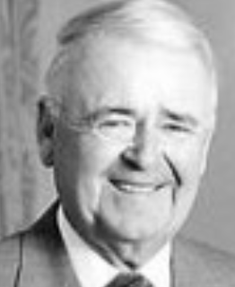
Legione v Hateley: Mason & Deane JJ
It is customary to recognize three general classes of estoppel, namely, of
record, of writing and in pais […]. Estoppel in pais includes both the common
law estoppel which precludes a person from denying an assumption which
formed the conventional basis of a relationship between himself and another
or which he has adopted against another by the assertion of a right based on
it and estoppel by representation which was of later development with origins
in chancery. It is commonly regarded as also including the overlapping
equitable doctrines of proprietary estoppel and estoppel by acquiescence or
encouragement.
Commercial Law CPD Conference 2025

Slide 8
Spot the estoppel
Estoppel of record (res judicata; issue estoppel; Anshun estoppel)
Estoppel of writing (estoppel by deed)
Estoppel in pais (estoppel by conduct)
  Common law estoppels:
    estoppel by representation
    estoppel by convention
  Equitable estoppels:
    Promissory estoppel
    Proprietary estoppel (by acquiescence or by encouragement)
Commercial Law CPD Conference 2025

Slide 9
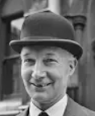
Legione v Hateley: Mason & Deane JJ
Emergence of equitable estoppel
Central London Property Trust Ltd v High Trees House: Denning J
As I have said they are not cases of estoppel in the strict sense. They are really promises - promises intended to be binding, intended to be acted on, and in fact acted on.
[T]here is strong authority in equity for a limited doctrine of promissory
estoppel — representations (or promises) as to future conduct — restricted to
precluding departure from a representation by a person in a pre-existing
contractual relationship that he will not enforce his strict contractual rights
Commercial Law CPD Conference 2025

Slide 10

Waltons Stores Interstate Ltd v Maher (1988) 164 CLR 387
Justice Brennan’s 6 elements of an equitable estoppel:
the assumption of a legal relationship;
inducement of the assumption or
expectation by the defendant;
reliance by the plaintiff;
knowledge or intention by the defendant
of that reliance;
detriment if the assumption or
expectation is not fulfilled; and
failure to avoid that detriment by the defendant.
Commercial Law CPD Conference 2025

Slide 11
Proprietary estoppel (interests in land)
Estoppel by acquiescence = passive form
B must be mistaken as to their legal rights;
B must expend money, or do some act, on the faith of their mistaken belief;
A must know of their own rights;
A must know of B's mistaken belief; and
"A must encourage B in [B’s] expenditure of money or other act, either directly or by abstaining from asserting [a] legal right”
Kramer v Stone (2024) 99 ALJR 126 at [55].
Estoppel by encouragement = active form
A need not know of acts done by B in reliance on the assumed state of affairs.
Commercial Law CPD Conference 2025

Slide 12
III. The latest from the High Court
Priya Wakhlu
Commercial Law CPD Conference 2025

Slide 13
Kramer v Stone
1975 - David entered into a share-farming agreement with Dame Leonie and Dr Harry.
1988 – Dame Leonie says to David
  Dr Harry had always admired David’s honesty and that Dr Harry and Dame Leonie had agreed that the Farm would pass to David upon Dame Leonie’s death together with a sum of money
2016 – Dame Leonie dies.
2017 - David commences proceedings seeking enforcement of Dame Leonie’s promise.
Commercial Law CPD Conference 2025

Slide 14
Kramer v Stone – Grounds of Appeal
Ground 1
Is it required that, after the promise, the owner perform some act of further encouragement of the farm worker to continue to share farm?
Ground 2
Does the owner have to have actual knowledge that the farm worker was relying on the promise which would be to his detriment if the promise were not fulfilled?
Commercial Law CPD Conference 2025

Slide 15
Kramer v Stone – First Ground of Appeal
The majority judgment (Chief Justice Gageler, Justice Gordon, Justice Edelman, Justice Beech-Jones) dismissed this ground of appeal and stated that:
  The principles of equitable estoppel are separate and independent from any equitable doctrine concerned with perfecting imperfect gifts, meaning there is no support in the authorities for an additional requirement encouragement by the promisor, subsequent to the promise.
Commercial Law CPD Conference 2025

Slide 16
Kramer v Stone – Second Ground of Appeal
The court concluded that the knowledge element for proprietary estoppel by encouragement would be established if:
  a reasonable person in the position of the promisor would have expected; or
  the promisor actually expected, that the promise would be relied upon by the promisee in the general (detrimental) manner in which it was relied upon.
Commercial Law CPD Conference 2025

Slide 17
IV. Practical tips
Samuel Burt
Commercial Law CPD Conference 2025

Slide 18

Crown Melbourne Limited v Cosmopolitan Hotel (Vic) Pty Ltd: Nettle J
What is determinative in cases of promissory estoppel is whether the party sought to be estopped has played such a part in creating an assumption or expectation in the mind of a claimant, in reliance on which the claimant has acted to the claimant’s detriment, that it would be unconscionable for the estopped party to depart from the assumption or expectation before allowing the claimant reasonable time in which to revert to the status quo ante or, in some cases, at all […]
Neither of the latter cases supports the proposition that a statement must be objectively unambiguous in order to found a promissory estoppel, still less that it must be more certain in terms than is required to found an agreed variation of contract.
Commercial Law CPD Conference 2025

Slide 19
V. Concluding remarks; Q&A
Cam Truong KC
Commercial Law CPD Conference 2025

Slide 20
Any questions?
Commercial Law CPD Conference 2025

Slide 21
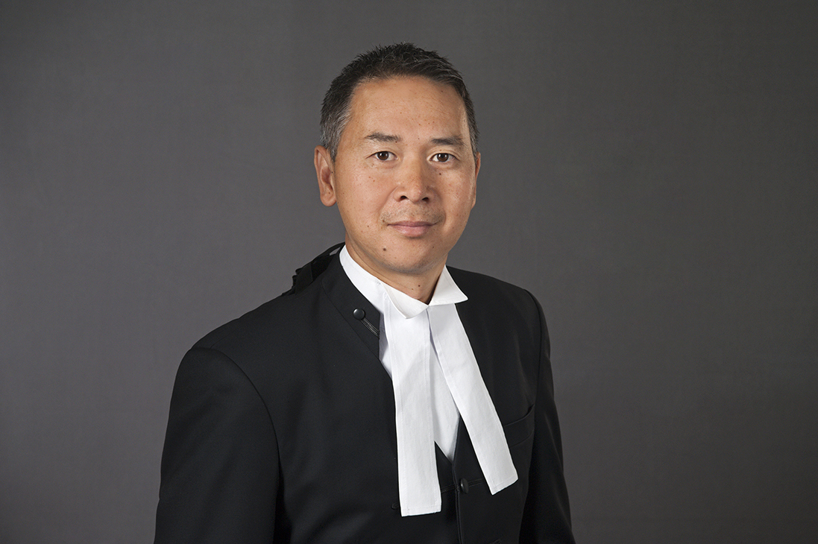



If your client isn’t having a good time,
give us a call
Cam Truong KC
T: 9225 8388
M: 0417 306 638
E: camtruong@vicbar.com.au
foleys.com.au/barristers/
cam-h-truong-kc
Samuel Burt
T: 9225 7777
M: 0417 306 638
E: samueloburt@vicbar.com.au
foleys.com.au/barristers/
samuel-burt
Scott Cromb
T: 9225 7072
M: 0413 039 131
E: scott.cromb@vicbar.com.au
foleys.com.au/barristers/
scott-cromb
Priya Wakhlu
T: 9225 7777
M: 0400 597 553
E: priya.wakhlu@vicbar.com.au
foleys.com.au/barristers/
priya-wakhlu
Commercial Law CPD Conference 2025

